Slide 1
AI MODEL GENERATOR
BATCH MEMBERS:
AGASH RAJEEV A 953220106002
ASHOK KUMAR A 953220106005
VETRISELVAN G 953220106041
UNDER THE GUIDANCE OF
DR C PETER DEVADOSS M.E, Ph.D.

Slide 2
CONTENTS
ABSTRACT
LITERATURE SURVEY
BLOCK DIAGRAM
EXPLANATIONS
RESULT & DISCUSSION
APPLICATION
CONCLUSION
REFERENCE

Slide 3

ABSTRACT
The project introduces a platform designed to simplify the selection and creation of pre-trained AI models tailored for specific tasks.
Users define data structures or input datasets for AI model generation.
System evaluates model performance and enables predictions.
Features user-friendly interface and automated processes.
Designed to democratize AI, ensuring accessibility for users of all technical backgrounds.

Slide 4
LITERATURE SURVEY
Title & Publication Details : | Methodology Used : | Advantages : | Author :
Health Insurance Amount Prediction Using Supervised Learning. Publication : IEEE Xplore.(2022) | Supervised learning - linear regression model. | Used to predict the health insurance amount. | Shruti Aggarwal,Anmol.
Customer Relationship Management for Supermarkets Using K-Means and RFM. Publication : IEEE Xplore.(2022) | Unsupervised learning- K-Means Clustering. | Clustering of customers based on RFM. | Xinyue Chen,Zhixue Zhang.

Slide 5
LITERATURE SURVEY
Title & Publication Details : | Methodology Used : | Advantages : | Author :
A Deep Learning Model for Predicting Buy and Sell in Stock Exchange of Thailand using Long Short-Term Memory. Publication : IEEE Xplore.(2019) | LSTM – Recurrent Neural Network. | Can predict stock exchange price. | Saichon Jaiyen,Kamol Keatruangkamala.
Machine Learning Based Weather Prediction Model for Short Term Weather Prediction in Sri Lanka Publication : IEEE Xplore.(2021) | LSTM – Recurrent Neural Network. | Can predict weather. | K.M.S.A.Hennayake,Randima Dinalankara.

Slide 6
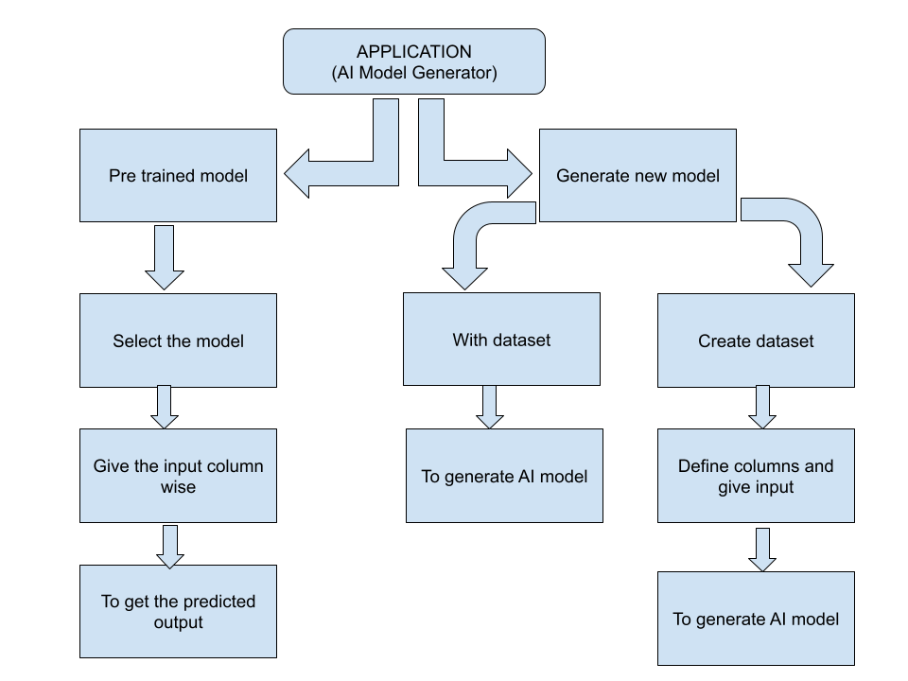
BLOCK DIAGRAM

Slide 7
EXPLANATIONS
Pre-trained AI model - Machine learning model that has been trained on a large dataset beforehand, enabling it to perform specific tasks effectively with reduced training time.
Select the model – from the list of pre trained AI models.
The user has to give the input for the respective columns.
The output will be produced by the AI model generator as per the input given by the user.
Generate new AI model – User can also generate the new AI model by defining the entire dataset.
User can also create dataset by defining the entire rows and columns.
The AI model generator create the AI model for the respective dataset give by the user and evaluate the result.
Then the generated model can predict the result based on the inputs given by the user.

Slide 8
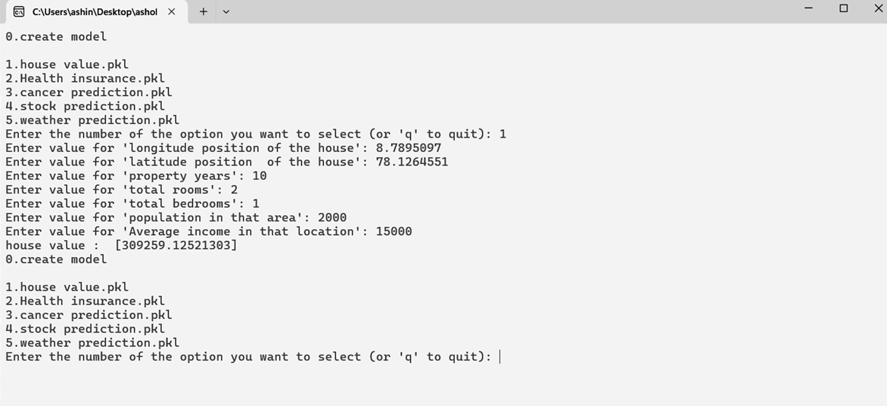
EXPLANATIONS
1.House Value Prediction:
The value of the house is predicted as 309259

Slide 9
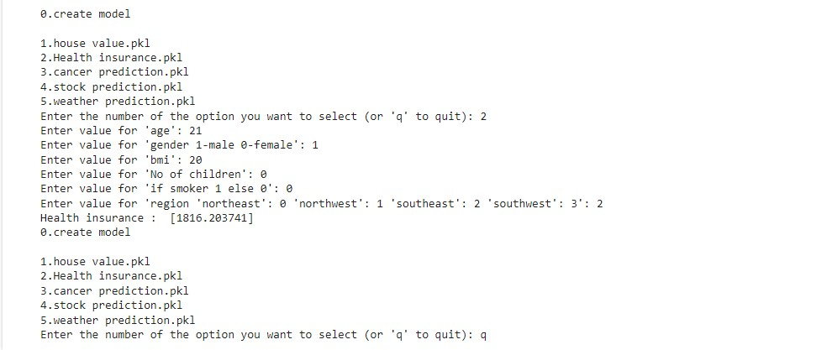
EXPLANATIONS
2.Health Insurance prediction:
The health insurance amount is predicted as 1816.2

Slide 10
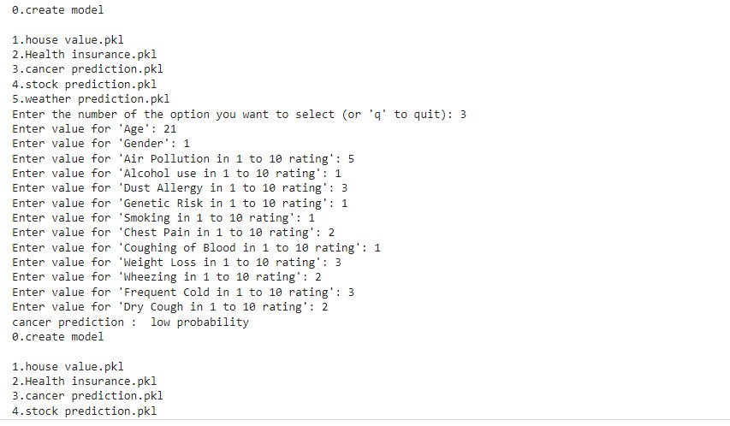
EXPLANATIONS
3.Cancer prediction:
The cancer is predicted as low probability.

Slide 11
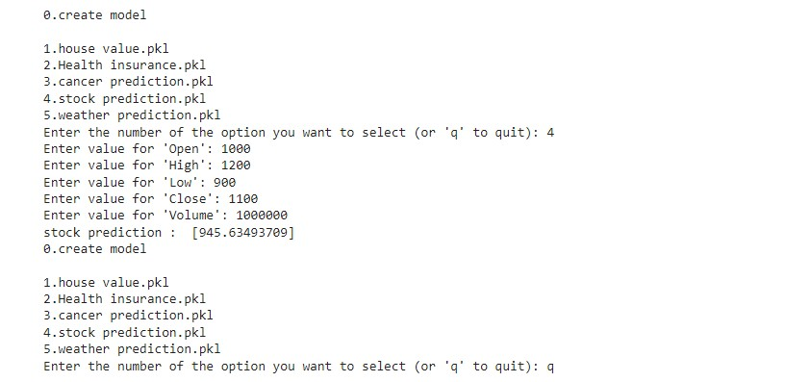
EXPLANATIONS
4.Stock Prediction:
The stock is predicted as 945.6

Slide 12
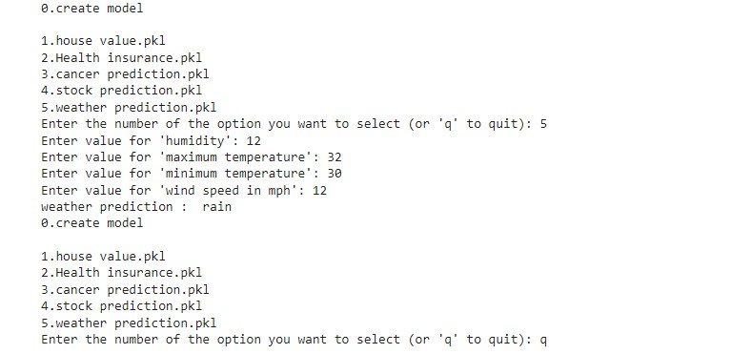
EXPLANATIONS
5.Weather Prediction:
The weather is predicted as Rain.

Slide 13
EXPLANATIONS
AI Model Generator Command-Line Interface:
Launch the Program:
The program starts by displaying a welcome message and a list of available options for the user to choose from.
User Input:
The user is prompted to enter a number from 0 to 5 to select an option:
Entering '0' allows the user to create a new AI model.
Entering '1' to '5' selects a pre-trained model for specific tasks:
House Value Prediction
Health Insurance Prediction
Cancer Prediction
Stock Prediction
Weather Prediction
The user can also enter 'q' to quit the program.

Slide 14
EXPLANATIONS
Model Creation (Option 0):
If the user selects option '0', they are prompted to provide the necessary data to train a new AI model.
This includes specifying the dataset and any additional parameters required for model training.
Once the model is trained, it is saved for future use.
Model Prediction (Options 1 to 5):
If the user selects one of the pre-trained models (options 1 to 5), the corresponding model is loaded.
The user is prompted to input the required features for prediction.
The model processes the input and generates the predicted value based on the selected task (e.g., house value, health insurance premium, cancer diagnosis, etc.).
The predicted value is displayed to the user.
Repeat or Quit:
After obtaining the predicted value, the user is given the option to perform another prediction or to quit the program.
If the user chooses to continue, they can select another option or input new data for prediction.
If the user selects 'q', the program exits, and a farewell message is displayed.

Slide 15
EXPLANATIONS
AI Model Generator Internal Interface:
Load Dataset:
Load the dataset provided by the user.
Handle Missing Values:
Remove or impute null values in the dataset to ensure data integrity.
Encode Categorical Data:
Identify columns with data type 'object', indicating categorical variables.
Encode categorical variables using LabelEncoder to map categorical values to integers.
Split Dataset:
Split the dataset into training and testing datasets to evaluate model performance.
Typically, 70-80% of the data is used for training and the remaining for testing.
Determine Model Type:
Determine whether a classification or regression model is needed based on the nature of the target variable:
If the target variable is continuous, a regression model is required.
If the target variable is categorical, a classification model is needed.

Slide 16
EXPLANATIONS
Select Algorithm:
Based on the model type, select an appropriate algorithm from the list of available algorithms:
For Regression:
Linear Regression
Random Forest Regression
Gradient Boosting Regression
For Classification:
Logistic Regression
Random Forest Classification
Gradient Boosting Classification
Train Model:
Train the selected algorithm on the training dataset to learn patterns and relationships between features and the target variable.
Save Model:
After training, save the generated model as a .pkl file for future use.
Add the saved model to the list of available models for selection.

Slide 17
EXPLANATIONS
Predict Values:
When the user selects the model for prediction, load the corresponding saved model.
Input the required features for prediction.
Use the loaded model to predict the target variable based on the input features.
Evaluate Model:
Evaluate the performance of the model using appropriate evaluation metrics based on the model type:
For Regression: Mean Squared Error (MSE), R-squared (R²), etc.
For Classification: Accuracy, Precision, Recall, F1-score, Confusion Matrix, etc.
Display the evaluation results to the user for assessment.
Provide Results:
Provide the predicted values to the user.
Display the evaluation results to assess the model's performance and reliability.

Slide 18
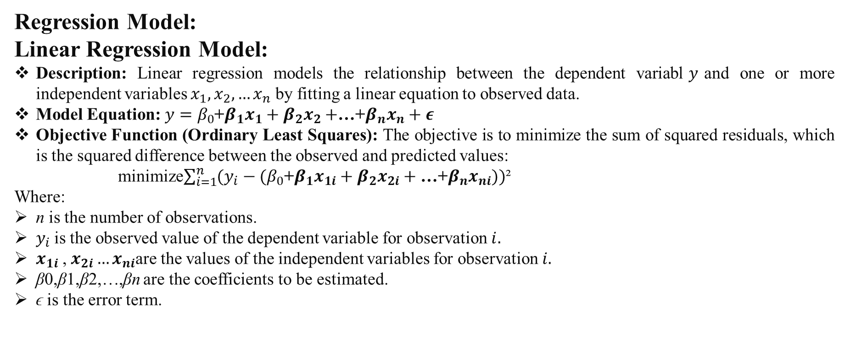
EXPLANATIONS
Regression Model:
Linear Regression Model:
Description: Linear regression models the relationship between the dependent variabl$y$and one or more independent variables $x_{1},x_{2},…x_{n}$​ by fitting a linear equation to observed data.
Model Equation: $y=β_{0}$+$β_{1}x_{1}+β_{2}x_{2}+$…+$β_{n}x_{n}+ε$
Objective Function (Ordinary Least Squares): The objective is to minimize the sum of squared residuals, which is the squared difference between the observed and predicted values:
minimize$\sum_{i=1}^{n}{(y_{i}−(β_{0}\text{+}β_{1}x_{1i}+β_{2}x_{2i}+\text{…+}β_{n}x_{ni}))}$²
Where:
n is the number of observations.
$y_{i}$is the observed value of the dependent variable for observation $i.$
$x_{1i}$, $x_{2i}…x_{ni}$are the values of the independent variables for observation $i.$
β0​,β1​,β2​,…,βn​ are the coefficients to be estimated.
ϵ is the error term.

Slide 19
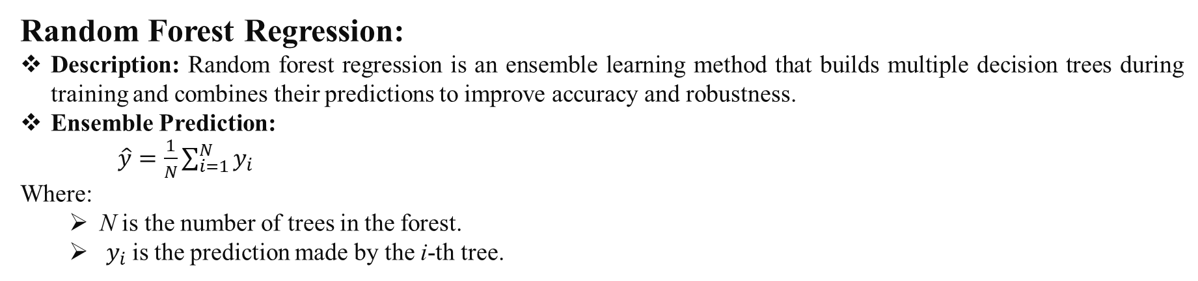
EXPLANATIONS
Random Forest Regression:
Description: Random forest regression is an ensemble learning method that builds multiple decision trees during training and combines their predictions to improve accuracy and robustness.
Ensemble Prediction:
$\hat{y}=\frac{1}{N}\sum_{i=1}^{N}{y_{i}}$
Where:
N is the number of trees in the forest.
​ $y_{i}$is the prediction made by the i-th tree.

Slide 20
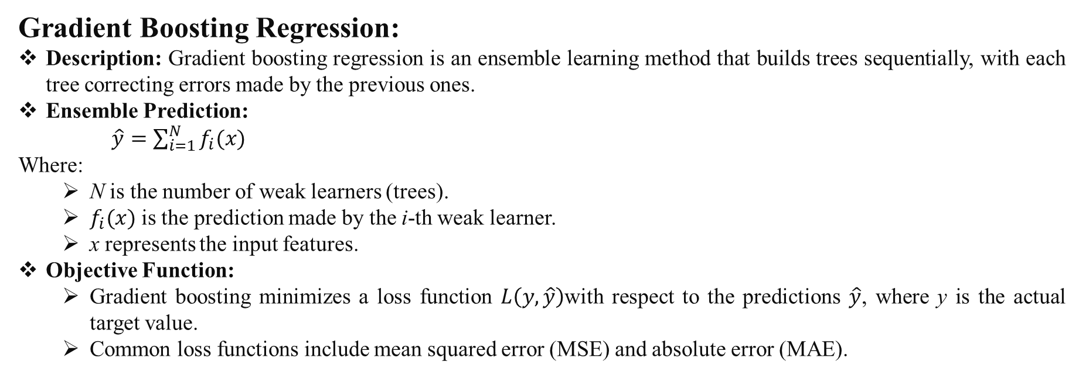
EXPLANATIONS
Gradient Boosting Regression:
Description: Gradient boosting regression is an ensemble learning method that builds trees sequentially, with each tree correcting errors made by the previous ones.
Ensemble Prediction:
$\hat{y}=\sum_{i=1}^{N}{f_{i}(x)}$
Where:
N is the number of weak learners (trees).
$f_{i}(x)$is the prediction made by the i-th weak learner.
x represents the input features.
Objective Function:
Gradient boosting minimizes a loss function $L\left(y,\hat{y}\right)$with respect to the predictions $\hat{y}$​, where y is the actual target value.
Common loss functions include mean squared error (MSE) and absolute error (MAE).

Slide 21
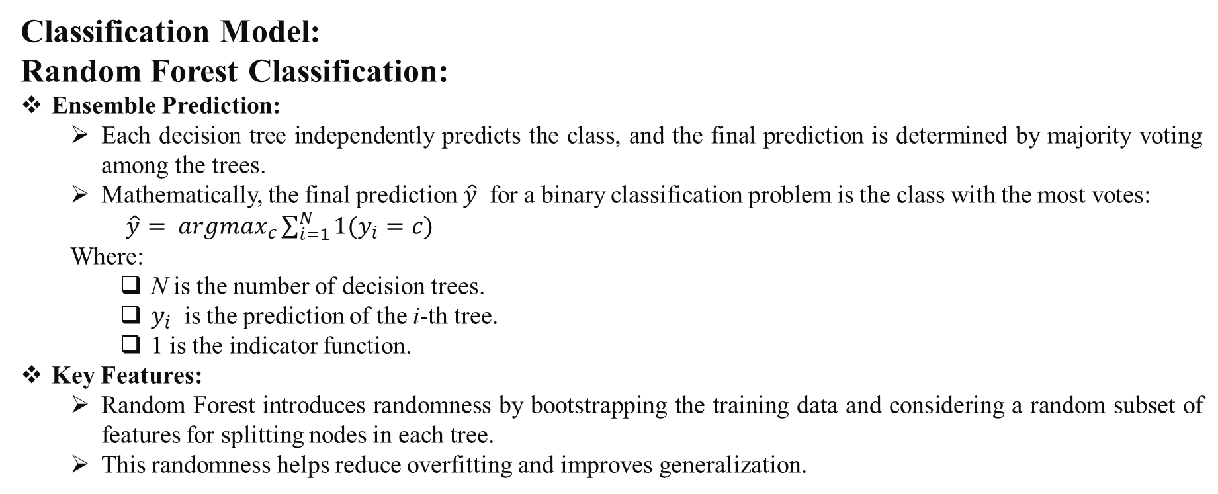
EXPLANATIONS
Classification Model:
Random Forest Classification:
Ensemble Prediction:
Each decision tree independently predicts the class, and the final prediction is determined by majority voting among the trees.
Mathematically, the final prediction $\hat{y}$​ for a binary classification problem is the class with the most votes:
$\hat{y}= {argmax}_{c}\sum_{i=1}^{N}{1(y_{i}=c)}$
Where:
N is the number of decision trees.
$y_{i}$​ is the prediction of the i-th tree.
1 is the indicator function.
Key Features:
Random Forest introduces randomness by bootstrapping the training data and considering a random subset of features for splitting nodes in each tree.
This randomness helps reduce overfitting and improves generalization.

Slide 22
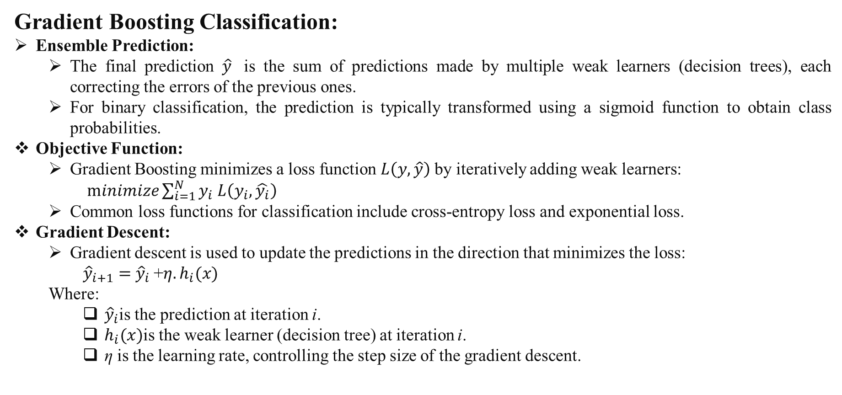
EXPLANATIONS
Gradient Boosting Classification:
Ensemble Prediction:
The final prediction $\hat{y}$​ is the sum of predictions made by multiple weak learners (decision trees), each correcting the errors of the previous ones.
For binary classification, the prediction is typically transformed using a sigmoid function to obtain class probabilities.
Objective Function:
Gradient Boosting minimizes a loss function $L\left(y,\hat{y}\right)$by iteratively adding weak learners:
$minimize\sum_{i=1}^{N}{y_{i}}$ $L\left(y_{i},\hat{y_{i}}\right)$
Common loss functions for classification include cross-entropy loss and exponential loss.
Gradient Descent:
Gradient descent is used to update the predictions in the direction that minimizes the loss:
${\hat{y}}_{i+1}=$ ${\hat{y}}_{i}$+$η.h_{i}(x)$
Where:
${\hat{y}}_{i}$is the prediction at iteration i.
$h_{i}(x)$is the weak learner (decision tree) at iteration i.
η is the learning rate, controlling the step size of the gradient descent.

Slide 23
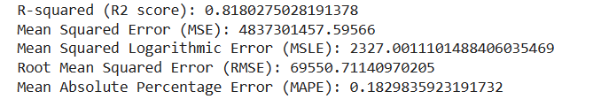
RESULT
1.House value prediction:
R-squared (R2 score): 0.818
Indicates approximately 81.8%
Mean Squared Error (MSE): 4,837,301,457.60
Represents the average squared difference between predicted and actual house values.
Mean Squared Logarithmic Error (MSLE): 2327.00
Reflects the average squared difference between the natural logarithm of predicted and actual house values.
Root Mean Squared Error (RMSE): 69,550.71
Provides the average deviation of predicted values from actual values.
Mean Absolute Percentage Error (MAPE): 0.183
Measures prediction accuracy as a percentage

Slide 24
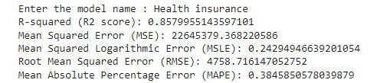
RESULT
2.Health insurance amount prediction:
R-squared (R2 score): 0.858
Indicates approximately 85.8%
Mean Squared Error (MSE): 22,645,379.37
Represents the average squared difference between predicted and actual health insurance amounts.
Mean Squared Logarithmic Error (MSLE): 0.243
Reflects the average squared difference between the natural logarithm of predicted and actual health insurance amounts.
Root Mean Squared Error (RMSE): 4,758.72
Provides the average deviation of predicted values from actual values.
Mean Absolute Percentage Error (MAPE): 0.385
Measures prediction accuracy as a percentage.

Slide 25
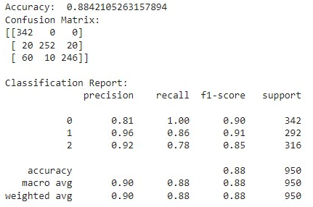
RESULT
3.Cancer prediction:
Accuracy: 88.4%
Confusion Matrix:
True Positives: 342
False Positives: 20
True Negatives: 252
False Negatives: 60
Classification Report:
Precision: Ranges from 0.81 to 0.96
Recall: Ranges from 0.90 to 1.00
F1-score: Ranges from 0.78 to 0.90
Macro Avg:
Precision: 0.88
Recall: 0.89
F1-score: 0.88
Weighted Avg:
Precision: 0.91
Recall: 0.88
F1-score: 0.88

Slide 26
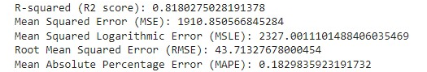
RESULT
4.Stock prediction:
R-squared (R2 score): 0.818
Indicates around 81.8%
Mean Squared Error (MSE): 1910.85
Represents the average squared difference between predicted and actual prices.
Mean Squared Logarithmic Error (MSLE): 2327.00
Reflects the average squared difference between the natural logarithm of predicted and actual prices.
Root Mean Squared Error (RMSE): 43.71
Provides the average deviation of predicted values from actual values.
Mean Absolute Percentage Error (MAPE): 0.18298
Measures prediction accuracy as a percentage.

Slide 27
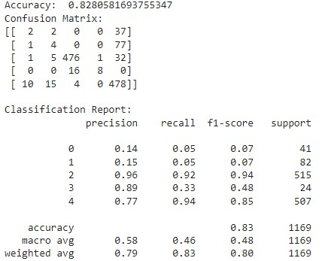
RESULT
5.Weather prediction:
Accuracy: The model predicts weather conditions accurately 82.8% of the time.
Precision:
Highest for predicting class 2 (clear weather) and class 4 (rainy weather).
Lowest for class 0 (uncertain weather) and class 1 (partly cloudy weather).
Recall:
Highest for class 4 (rainy weather).
Lowest for class 0 (uncertain weather) and class 1 (partly cloudy weather).
F1-score:
Highest for class 2 (clear weather) and class 4 (rainy weather).
Lowest for class 3 (stormy weather).

Slide 28
RESULT & DISCUSSION
Regression model:
R-squared (R2 score): Measures how well the model fits the data; higher values indicate better fit.
Mean Squared Error (MSE): Measures the average squared difference between predicted and actual values; lower values indicate better accuracy.
Mean Squared Logarithmic Error (MSLE): Similar to MSE but uses the logarithm of the predicted and actual values; useful for skewed datasets.
Root Mean Squared Error (RMSE): Square root of MSE; interpretable in the same units as the target variable.
Mean Absolute Percentage Error (MAPE): Measures the average percentage difference between predicted and actual values; lower values indicate better accuracy, but it doesn't handle zeros well.

Slide 29
RESULT & DISCUSSION
Classification model:
Accuracy:
Accuracy measures the overall correctness of the model's predictions.
It's calculated as the ratio of correctly predicted instances to the total instances.
Confusion Matrix:
Provides a snapshot of the model's performance by showing counts of true positives, true negatives, false positives, and false negatives.
Helps in understanding where the model is making errors and which classes it's confusing.
Classification Report:
Presents a detailed summary of the model's performance for each class.
Includes metrics such as precision, recall, F1-score, and support.
Precision:
Indicates the accuracy of positive predictions.
Ratio of correctly predicted positive observations to the total predicted positives.
Recall:
Measures the ability of the model to capture all positive instances.
Ratio of correctly predicted positive observations to all observations in the actual class.

Slide 30
RESULT & DISCUSSION
F1-score:
Represents the harmonic mean of precision and recall.
Provides a balance between precision and recall.
Support:
Indicates the number of actual occurrences of the class in the dataset.
Accuracy, Macro Average, Weighted Average:
Accuracy:
Overall correctness of the model across all classes.
Macro Average:
Unweighted mean of precision, recall, and F1-score across all classes.
Gives equal weight to each class.
Weighted Average:
Weighted mean of precision, recall, and F1-score across all classes, considering the number of instances of each class.
Useful when dealing with class imbalance.

Slide 31
APPLICATION
Rapid Prototyping:
Facilitates quick prototyping and testing of machine learning models.
Eliminates the need to write extensive code from scratch.
Automated Model Creation:
Automates the process of creating machine learning models.
Handles data preprocessing, feature selection, model training, and evaluation.
Custom Model Development:
Enables the creation of custom machine learning models tailored to specific use cases.
Addresses unique business challenges or opportunities.
Predictive Analytics:
Builds predictive models for forecasting sales, demand, customer behavior, or market trends.
Supports data-driven decision-making and operational optimization.
Personalization:
Develops recommendation systems and personalized marketing campaigns.
Enhances user experience and engagement based on user preferences.
Risk Assessment:
Creates models for risk assessment in finance, insurance, healthcare, and cybersecurity.
Identifies and mitigates risks proactively.

Slide 32
APPLICATION
Anomaly Detection:
Builds anomaly detection models to identify unusual patterns or outliers in data.
Useful for fraud detection, network security, and quality control.
Optimization:
Optimizes processes, resources, and decision-making.
Includes supply chain optimization, resource allocation, and inventory management.
Customer Insights:
Analyzes customer data to generate insights into preferences, sentiment, and churn prediction.
Improves customer satisfaction and retention strategies.
Healthcare and Life Sciences:
Develops models for disease diagnosis, drug discovery, patient monitoring, and personalized medicine.
Advances healthcare and life sciences research and practice.
Environmental Monitoring:
Analyzes environmental data for monitoring climate change, pollution levels, and natural disasters.
Supports environmental conservation and sustainability efforts.
Education and Research:
Utilizes AI models for data analysis, pattern recognition, and predictive modeling in various fields.
Enhances research and educational outcomes in diverse disciplines.

Slide 33
CONCLUSION
Cancer Prediction and Health Insurance Amount Prediction models stand out for their high accuracy scores of 88.4% and 85.8% respectively, indicating strong predictive capabilities and potential practical applicability.
Weather Prediction model, although achieving a slightly lower accuracy of 82.8%, showcases balanced precision and recall values across different weather classes, suggesting reliability in predicting diverse weather conditions.
House Value Prediction model demonstrates moderate performance with an R2 score of 0.818, indicating a reasonable fit to the data, but may require further refinement for improved accuracy.
Stock Prediction model also exhibits moderate performance with an R2 score of 0.818, implying a relatively good fit to the stock price data, yet higher errors compared to other models may necessitate additional optimization efforts.

Slide 34
REFERANCE
General AutoML libraries:
TPOT: Open-source AutoML library for scikit-learn: https://github.com/telekom-security/tpotce
Auto-Keras: Efficient automatic model search for Keras: https://www.tensorflow.org/tutorials/keras/keras_tuner
Transfer Learning Libraries:
TensorFlow Hub: Repository of pre-trained models for TensorFlow: https://www.tensorflow.org/hub
PyTorch Hub: Community of pre-trained models for PyTorch: https://pytorch.org/hub/
Scikit-learn model zoo: Pre-trained scikit-learn models: https://scikit-learn.org/
Additional Resources:
Google AutoML: https://cloud.google.com/automl
Papers with Code: https://paperswithcode.com/ (search for "AutoML", "NAS", "Transfer Learning")

Slide 35
THANK YOU…

